Slide 1
DATA SCIENCE Predicting Doctor Prescriptions Using Machine Learning

Slide 2
TABLE OF CONTENTS
01
04
02
05
03
06
Introduction to the project
Data Preprocessing
Data Manipulation & Cleaning
Model Selection
Data Visualization
Model Evaluation

Slide 3
01
About the project

Slide 4
INTRODUCTION
This project aims to develop a machine learning model to predict whether a doctor will prescribe a recommended medication based on data from interactions between medical representatives and doctors. The dataset includes various features, such as doctor specialization, type of medication, interaction history, and prescription patterns. By analyzing this data, the project seeks to uncover the key factors that influence prescription decisions and develop an accurate predictive model that can assist in optimizing sales strategies for pharmaceutical companies.

Slide 5
WHAT WE ARE WORKING ON
OBJECTIVE
Predict whether a doctor will prescribe medication based on a medical representative's recommendation.
DATASET
Contains doctor details and interactions with medical representatives.
METHODOLOGY
Data cleaning, visualization, preprocessing, and machine learning models.

Slide 6

DATA PROJECT ARCHITECTURE
Data Cleaning
Data Visualization
Data Preprocessing
Modeling
Hyperparameter Tuning
Model Evaluation

Slide 7
02
DATA MANIPULATION

Slide 8
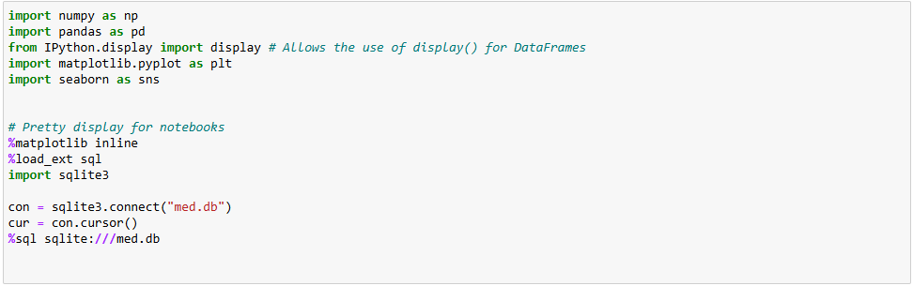
Importing Libraries & Connecting to Database

Slide 9
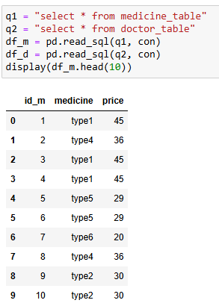
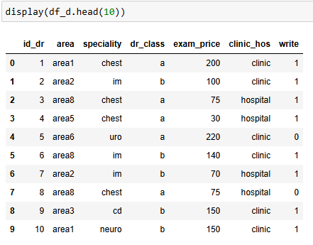
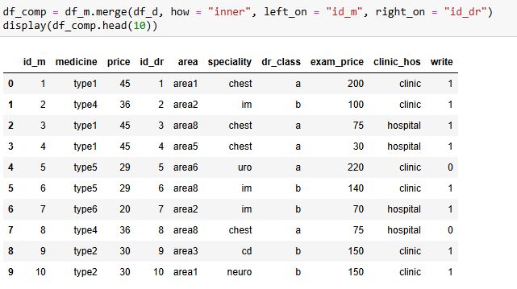
First, we’ll have to Join the two tables

Slide 10
2.1
DATA CLEANING

Slide 11
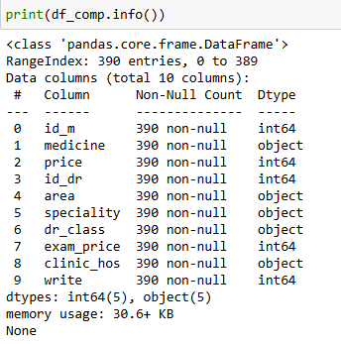

Let's Explore our data for cleaning and find out if there is duplicated data or NULLs

Slide 12
We concluded that there is no NULL data or duplication

Slide 13
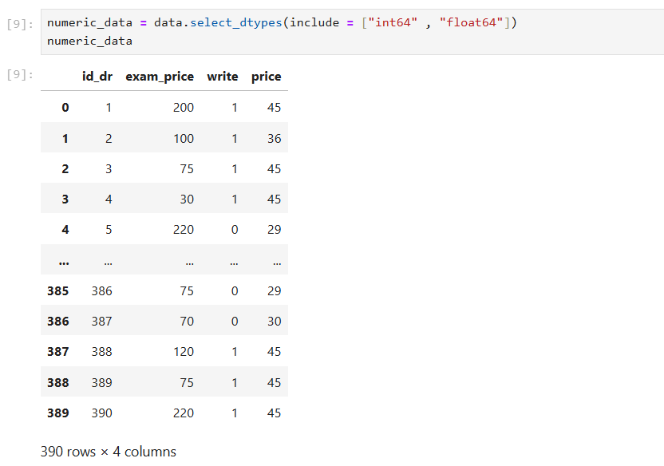
First we select the numeric data ONLY

Slide 14
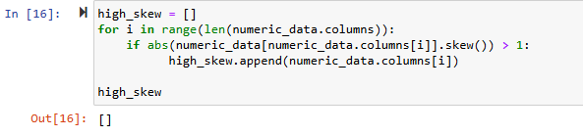
Check for skewness of data

Slide 15
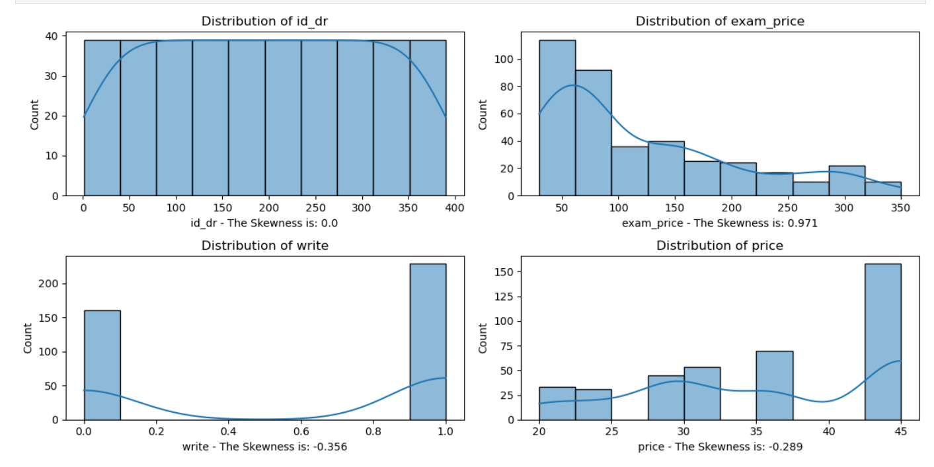
Analysis of skewness in data
No skewness detected..

Slide 16
Conclusion
Since there is no significant skewness in the data, we can proceed with analyses that assume normality without concern for the biases introduced by skewed distributions.

Slide 17
2.2
DATA
EXPLORATION

Slide 18
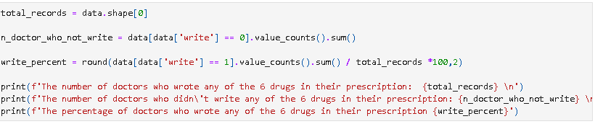
Analyze the number of doctors prescribing any of the 6 drugs and compute related statistics.
Key Metrics:
Total Number of Records: 390
Doctors who wrote any of the 6 drugs: 229
Doctors who didn't write any of the 6 drugs: 161
Percentage of doctors who wrote any of the 6 drugs: 58.72%

Slide 19
03
DATA
VISUALIZATION

Slide 20
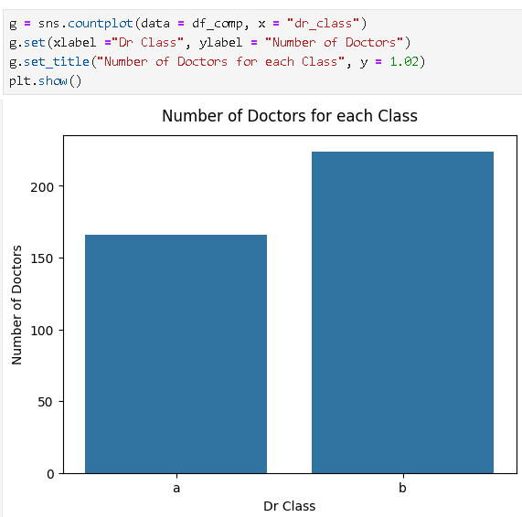
Number of doctors for each class
Number of doctors with class a is 166
Number of doctors with class b is 224

Slide 21
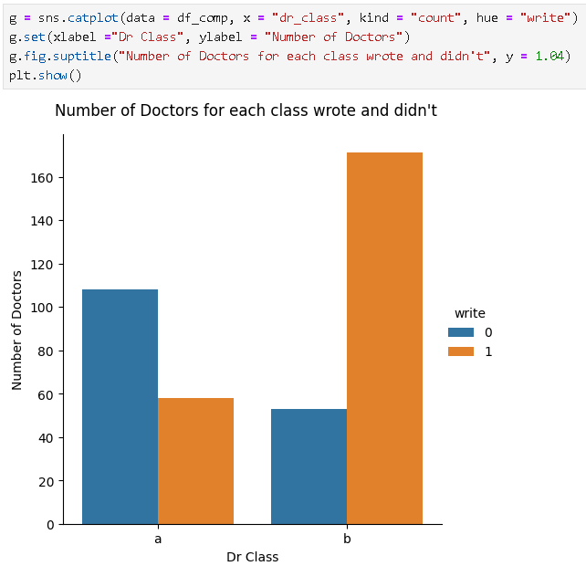
Number of doctors for each class who wrote the medicine VS. who didn't
Doctors who wrote the medicine from class a is 58.
Doctors who wrote the medicine from class b is 171.
Doctors who didn't write the medicine from class a is 108.
Doctors who didn't write the medicine from class b is 53.

Slide 22
Key findings:
Number of doctors wrote the medicine in class b exceeds the number of class a.
Doctors with class a who wrote the medicine is almost equal to doctors with class b who didn't write the medicine.

Slide 23
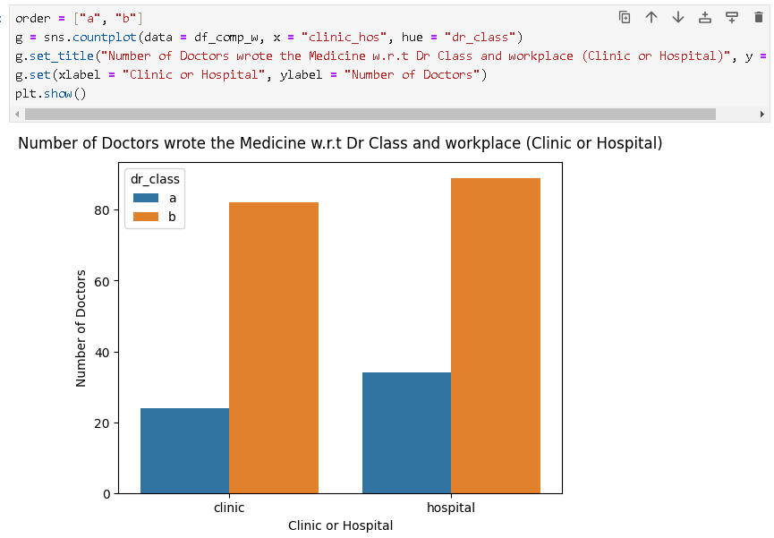
Dr Class and Workplace
No. of doctors with class b in clinic is extremely equal to no. of doctors in hospital

Slide 24
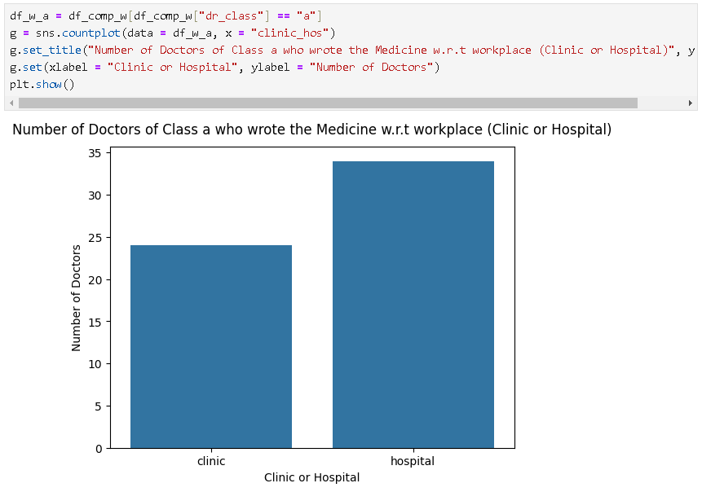
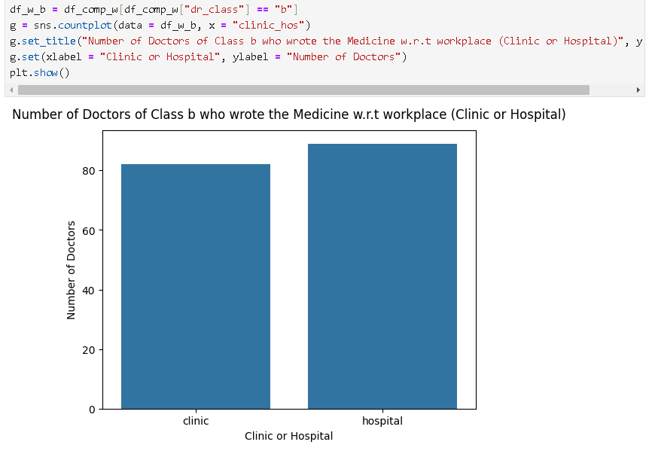
Number of Doctors of who wrote in each class and Workplace
In both classes doctors who wrote the medicine in hospital are more than doctors who wrote the medicine in clinics.
Class a
Class b

Slide 25
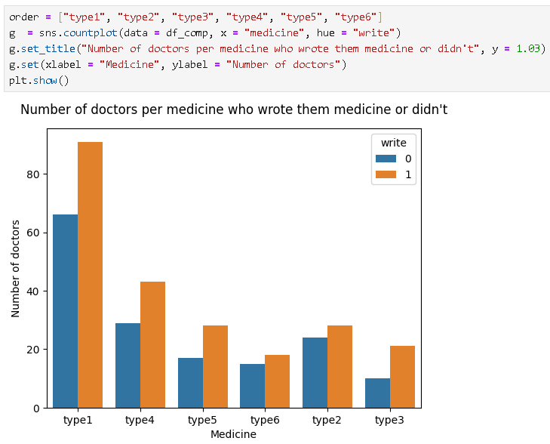
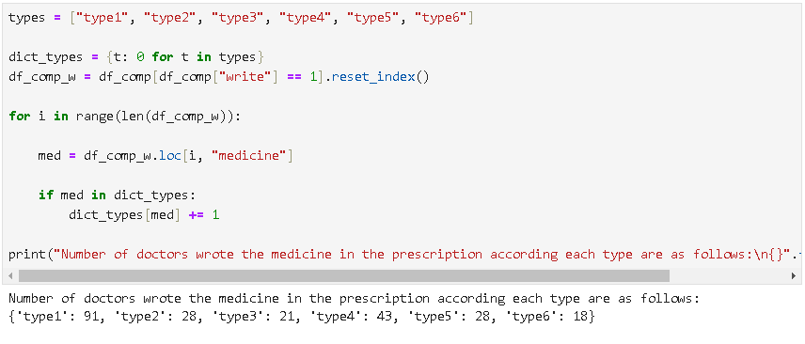
Most written medicine
For each type of the medicine the written prescription exceeds the un written.
Most written medicine is type 1.

Slide 26
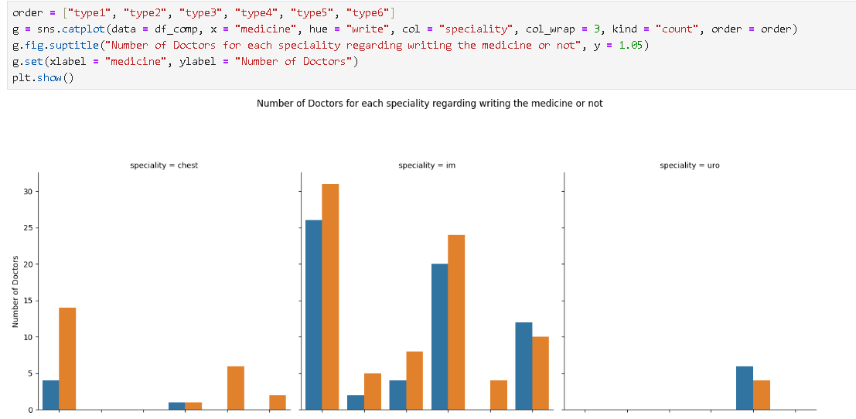
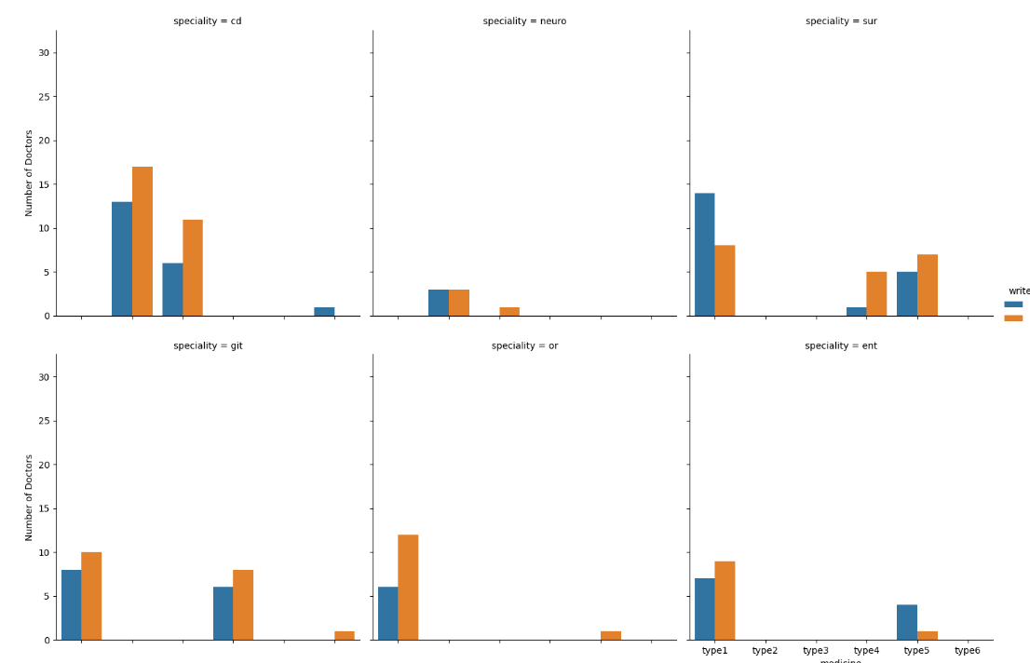
Speciality column analysis
Only the specialities gp and im are using the all 6 types it will be a good decision to focus on the doctors with these specialities.
Also it will be a good choice to avoid the following specialties: vas, uro.
Avoid targeting class a in uro,vas speciality.
Avoid type 1 in sur speciality.
Avoid targeting class a in type 6 with im speciality.
Avoid type 5 in ent speciality.

Slide 27
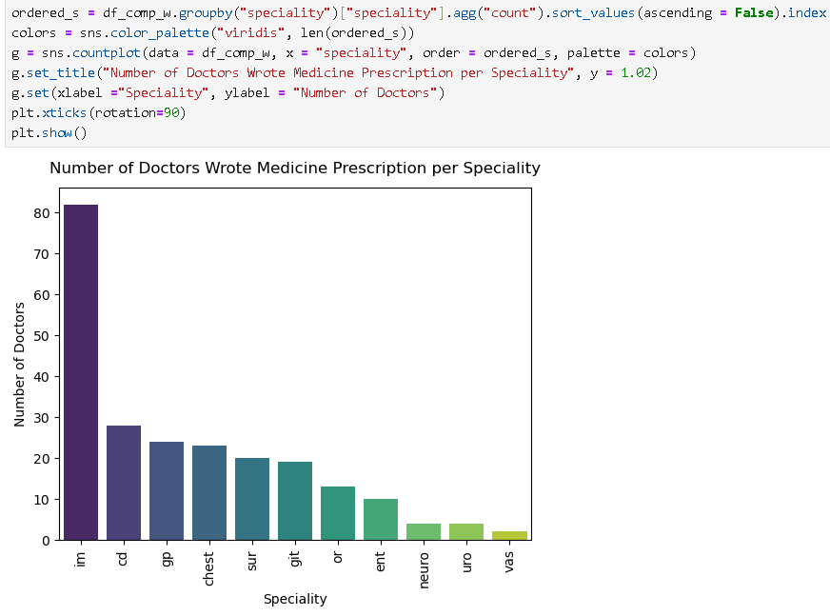
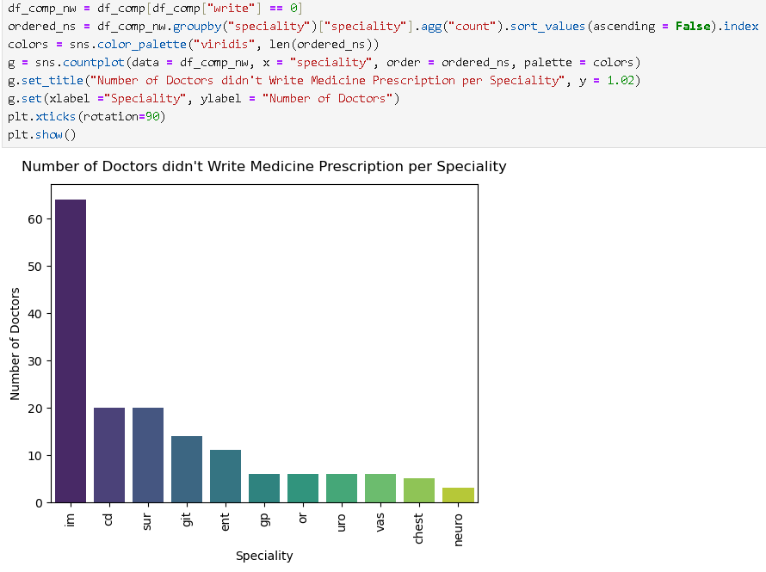
Number of doctors write & didn’t write per speciality

Slide 28
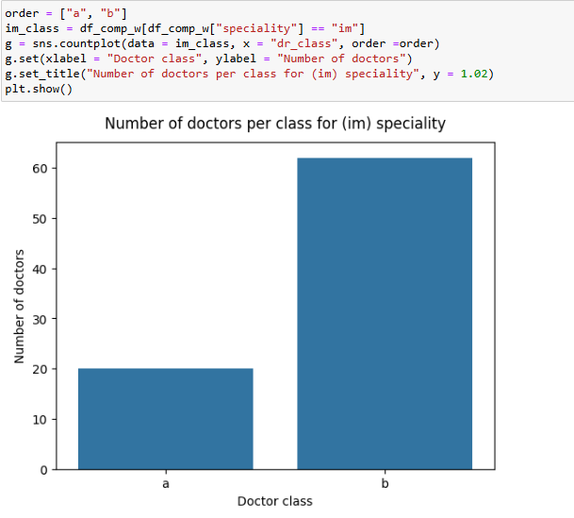
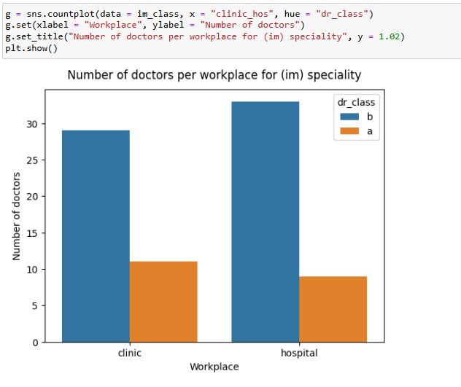
IM Speciality

Slide 29
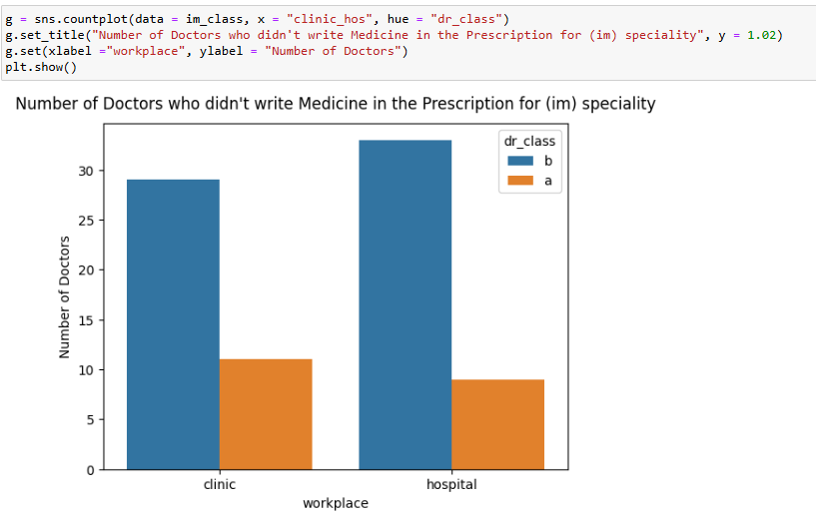
Number of Doctors who didn't write Medicine for (im) speciality
Speciality (im) is the most written and unwritten speciality and doctors in clinic are more likely not to write the medicine.
For the (im) speciality doctors with b class are more likely to write the medicine in the prescription.

Slide 30
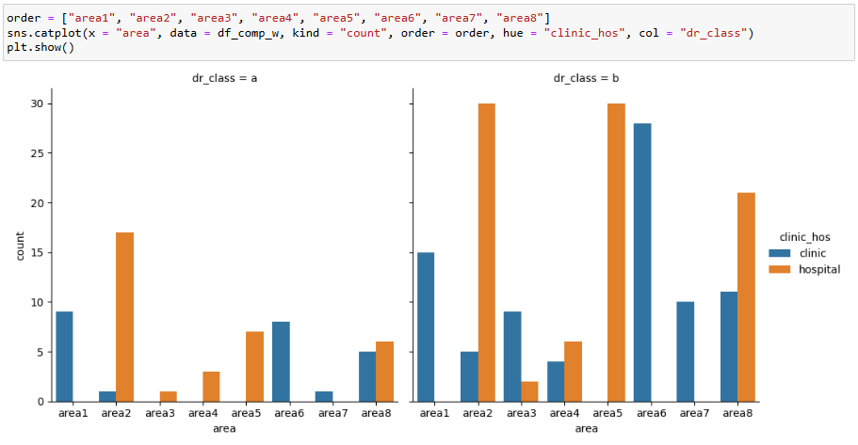
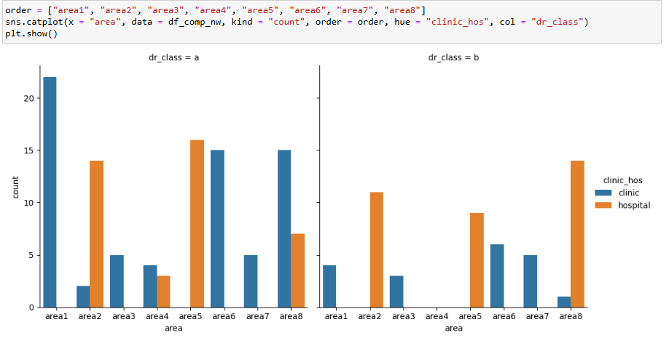
Targeting doctors within specific area
]:
It will be a good decision to do the following to be more efficient on targeting doctors w.r.t area.
Focus on class b doctors only in area 1.
Focus on hospitals only for area 3 for class a doctors
In area 4 focus on class b doctors.
Avoid dealing with doctors with class a in area 5, area 6 and area 7.

Slide 31
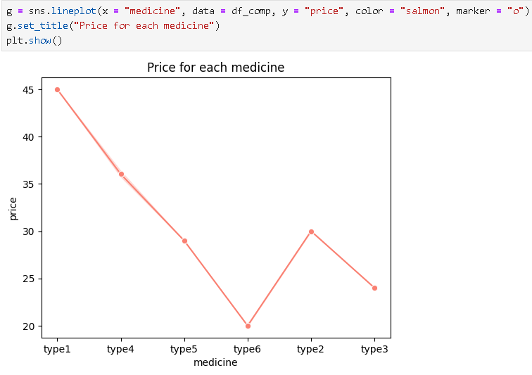
Medicine Price

Slide 32
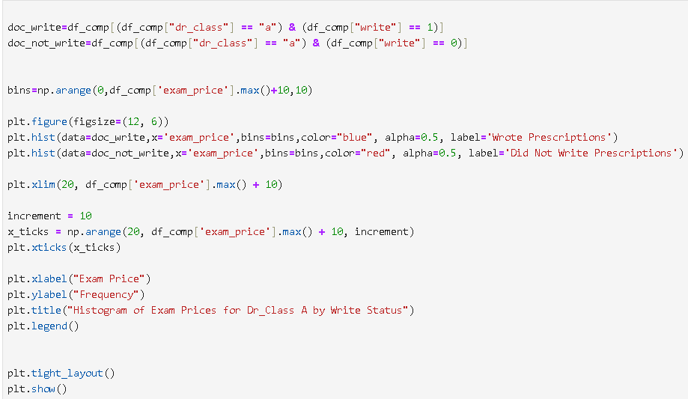
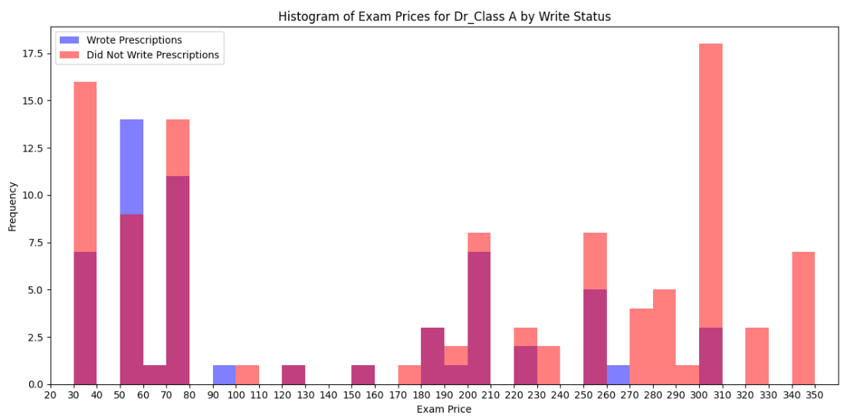
Exam price for class-a

Slide 33
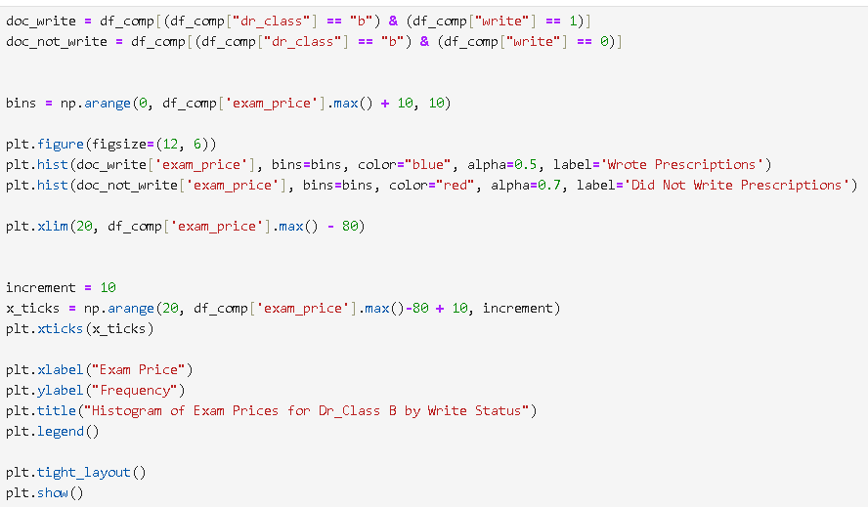
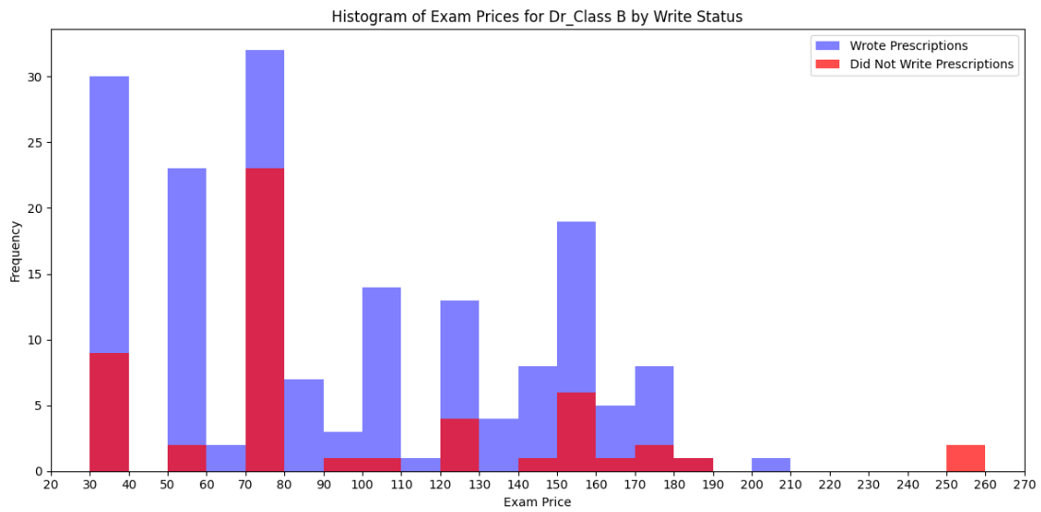
Exam price for class-b

Slide 34
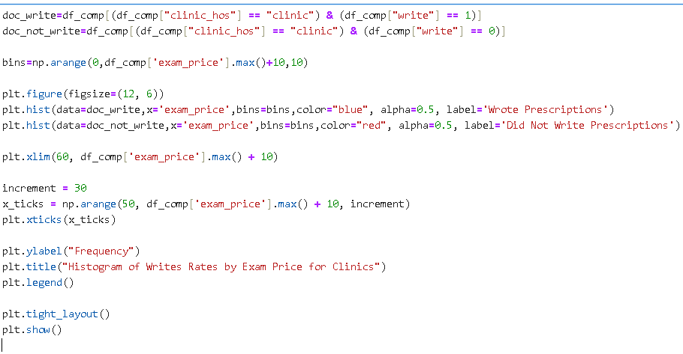
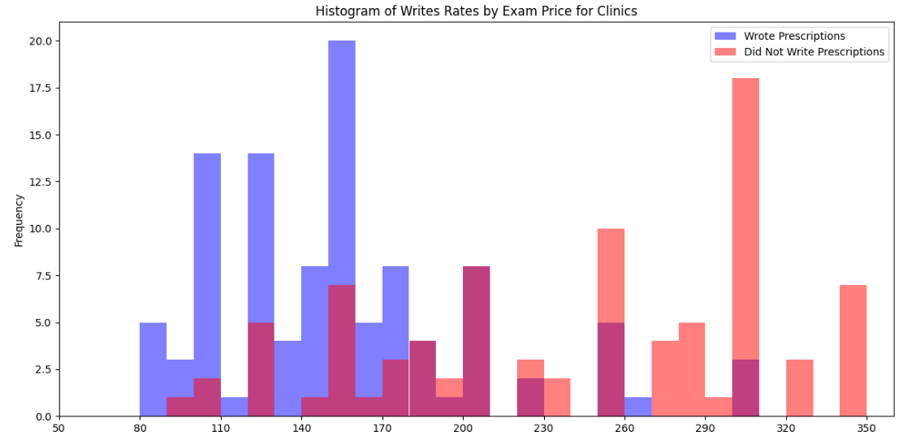
Writes Rates by Exam Price for Clinics
For exam price in the clinic more than 180 number of doctors wrote the exam is always less than the doctors who didn't

Slide 35
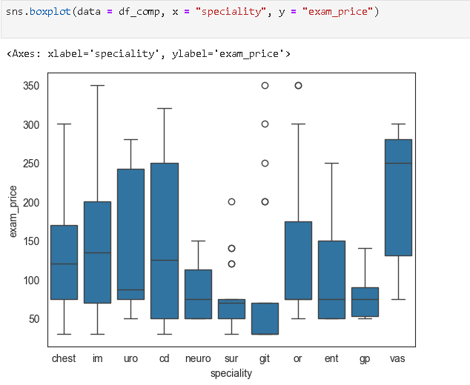
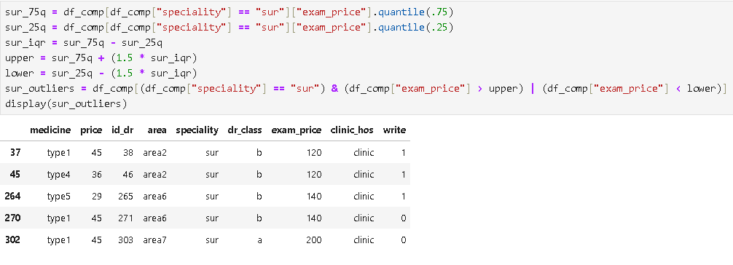
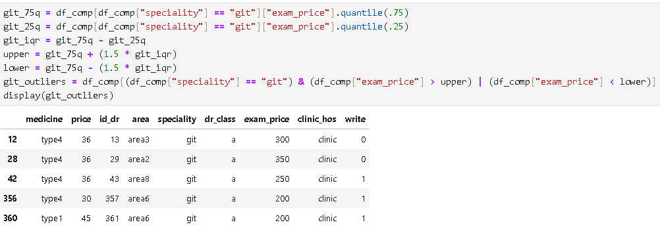
Distribution of exam_price across different specialties.

Slide 36
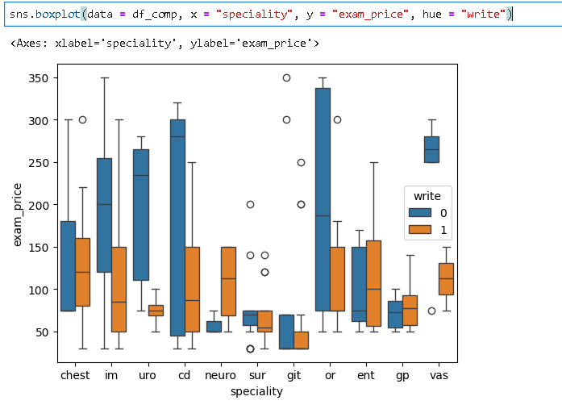
According the previous outlier analysis most of the doctors who have very high exam price tend not to write the medicine.

Slide 37
Conclusion
number of doctors wrote the medicine in class b exceeds the number of class a.
doctors with class a who wrote the medicine is almost equal to doctors with class b who didn't write the medicine.
Number of Doctors wrote the medicine in the prescription in class b exceeds the same case with class a doctors.
in both classes doctors who wrote the medicine in hospital are more than doctors who wrote the medicine in clinics.
for each type of the medicine the written prescription exceeds the un written.
most written medicine is type 1.
only the specialities gp and im are using the all 6 types it will be a good decision to focus on the doctors with these specialities.
also it will be a good choice to avoid the following specialties: vas, uro.
avoid targeting class a in uro speciality.
avoid targeting class a in vas speciality.
avoid type 1 in sur speciality.
avoid targeting class a in type 6 with im speciality.

Slide 38
avoid type 5 in ent speciality.
speciality im is the most written and unwritten speciality and doctors in clinic are more likely not to write the medicine.
for the im speciality doctors with b class are more likely to write the medicine in the prescription.
focus on class b doctors only in area 1.
focus on hospitals only for area 3 for class a doctors.
in area 4 focus on class b doctors.
avoid dealing with doctors with class a in area 5, area 6 and area 7.
according outliers analysis most of the doctors who have very high exam price tend not to write the medicine.

Slide 39
04
DATA PREPROCESSING

Slide 40

CLUSTERING DATA
First: we’re going to select relevant features for clustering
Then, we’re going to use one-hot encoding for selected features

Slide 41


CLUSTERING DATA
Then, we’re going to initialize the K-means with 5 clusters
Fit the KMeans algorithm to the data

Slide 42
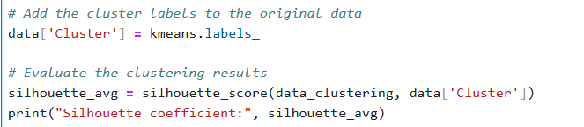
Lastly, we add the clustering label to the original data and evaluate the clustering results using the metric; silhouette score..

Slide 43
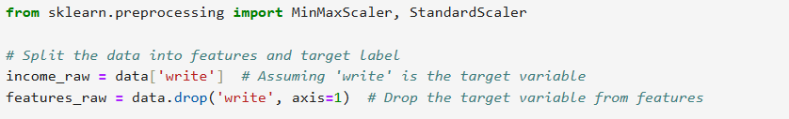
Splitting the data into features and target label!
Here we assume that the ‘write’ is the target variable, and so we drop it from the features.

Slide 44
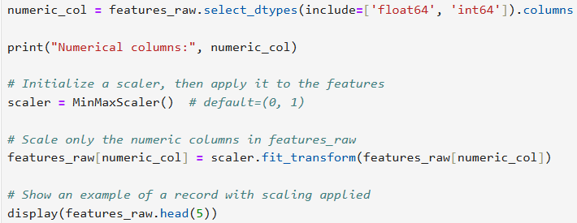
MinMaxScaler
By selecting the numerical features only, we will be able to fit transform the feature data.

Slide 45
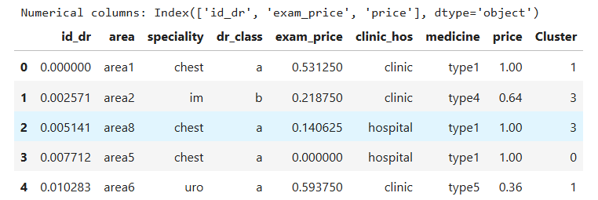
Display of data

Slide 46
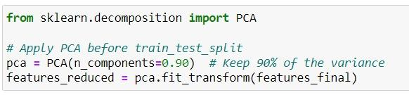
Apply principle components analysis

Slide 47
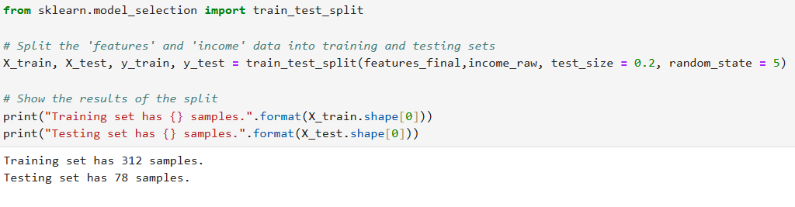
Splitting Data into Training set and test set
Split the data into 20% test set and 80% training set..

Slide 48
05
MODEL SELECTION

Slide 49
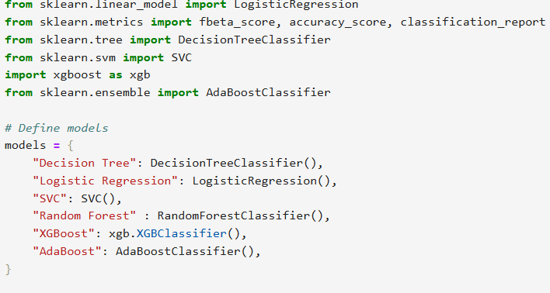
In this project, we will be using different machine learning models to try and achieve the best accuracy.
Decision Tree
Logistic Regression
SVC
Random Forest
XGBoost
AdaBoost

Slide 50

Initialization of the variables
Initialize variables to store the best model’s information

Slide 51
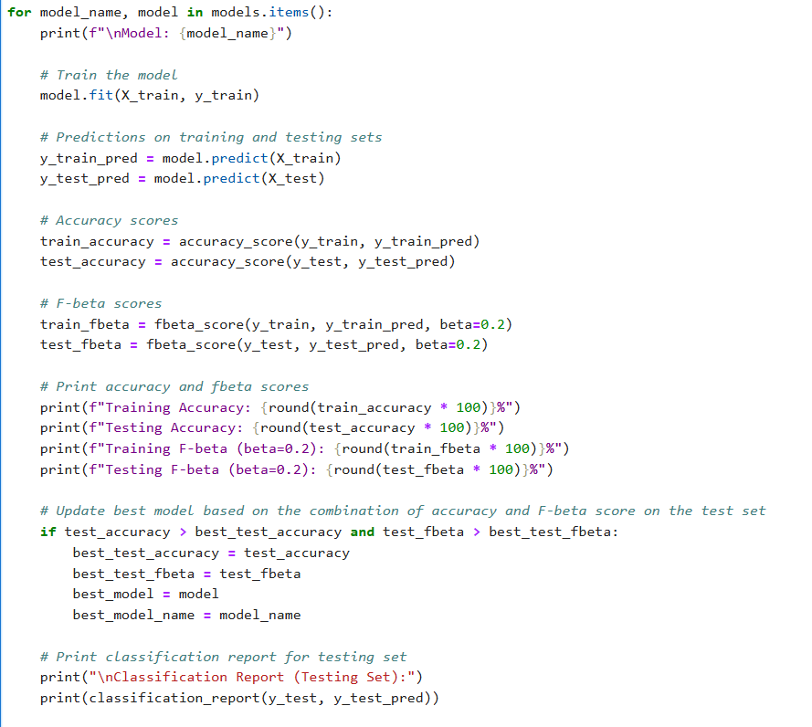
Model training
Train models.
Predict training and testing sets.
Accuracy scores for the training and testing
Train and test F-beta scores.
Print the results of the above.
Update the best model’s information.
Print the classification report for the testing set.

Slide 52
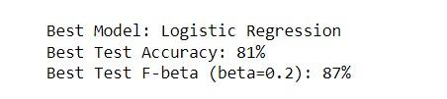
Display Results

Slide 53
05
MODEL EVALUATION

Slide 54
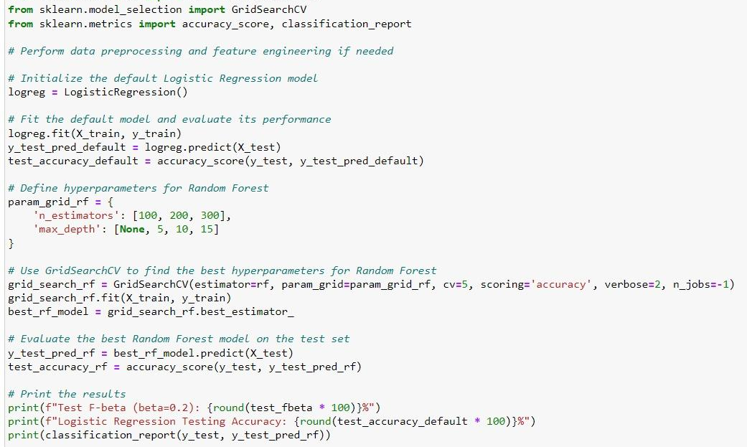
HYPERPARAMETER TUNING
Implement GridSearch for model selection:
Initialize the Logistic Regression model.
Use GridSearch to find the best hyperparameter in the model.
Fit the grid search model
Get the best parameters from the grid search.
Get the best Logistic Regression with the tuned parameters.
Evaluate the best model on the test set.
Calculate accuracy and fbeta for the tuned model.
Print best parameters and performance metrics.

Slide 55
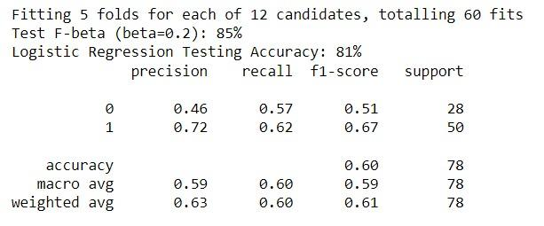
Display Results

Slide 56
Results
Best Performing Model
After evaluating multiple models, Logistic Regression was identified as the best-performing model.
Test Accuracy: 81%
Model Strengths
Logistic Regression demonstrated good performance with balanced precision and recall.
Effective in classifying doctor prescriptions with moderate accuracy based on available data.
Model Limitations
The accuracy (81%) shows that there is room for improvement with more feature engineering or more diverse data.
More complex models like XGBoost and Random Forest could be explored further with optimized hyperparameters.

Slide 57
Conclusion
Impact: The Logistic Regression model effectively predicted doctor prescriptions with a 81% accuracy and balanced precision and recall for both classes.
Significance: The high F-beta score (87%) indicates that the model performs well with emphasis on precision, making it valuable for use cases where false positives need to be minimized.
Future Work:
Further tuning and exploration of other algorithms such as XGBoost could improve accuracy.
Investigating more features and larger datasets may lead to better predictions.

Slide 58

THANKS
Any Questions?

